Slide 1

Porifera
Prepared by
Dr. Rawa Abdul Redha Aziz
Ph.D Antibiotics/ Molecular biology
Dr. Hiba Shakir Ahmed
Ph.D Microbiology/Immunity

Slide 2
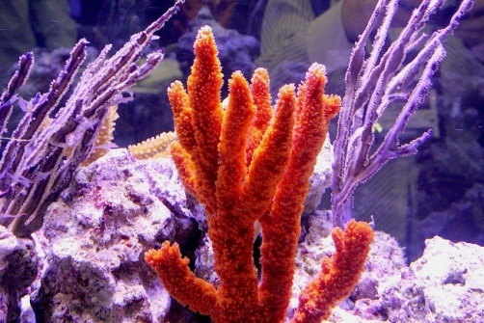
Phylum – Porifera
Phylum – Porifera includes organisms with holes.
They are primitive multicellular animals and have cellular level of organization.
They are non-motile animals attached to some solid support.
The body design involves very minimal differentiation and division into tissues.
They are commonly called sponges.
They are generally marine and mostly asymmetrical animals.
Sponges have a water transport or canal system.

Slide 3
Water enters through minute pores (Ostia) in the body wall into a central cavity, spongocoel, from where it goes out through the osculum.
This pathway of water transport is helpful in food gathering, respiratory exchange and removal of waste.
The body is supported by a skeleton made up of spicules or spongin fibres.
Sexes are not separate (hermaphrodite), i.e., eggs and sperms are produced by the same individual.
Sponges reproduce asexually by fragmentation and sexually by formation of gametes.
Fertilization is internal and development is indirect having a larval stage which is morphologically distinct from the adult.

Slide 4
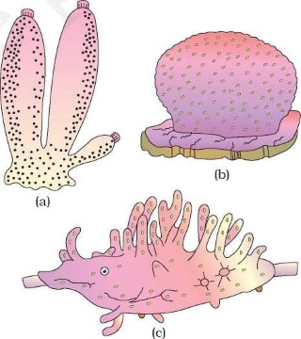
Figure: Examples of Porifera: (a) Sycon (Scypha) (b) Euspongia (Bath sponge) (c) Spongilla (Fresh water sponge)

Slide 5
Phylum – Chordata
Animals belonging to phylum Chordata are fundamentally characterised by the presence of a notochord, a dorsal hollow nerve cord and paired pharyngeal gill slits.
They are bilaterally symmetrical, triploblastic, coelomate with organ-system level of organisation.
They possess a post anal tail and a closed circulatory system.
Phylum Chordata is divided into three subphyla: Urochordata or Tunicata, Cephalochordata and Vertebrata.
Subphyla Urochordata and Cephalochordata are often referred to as protochordates and are exclusively marine

Slide 6
In Urochordata, notochord is present only in larval tail, while in Cephalochordata, it extends from head to tail region and is persistent throughout their life.
Examples: Urochordata – Ascidia, Salpa, Doliolum; Cephalochordata – Amphioxus or Lancelet

Slide 7
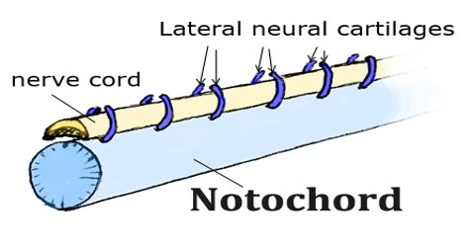
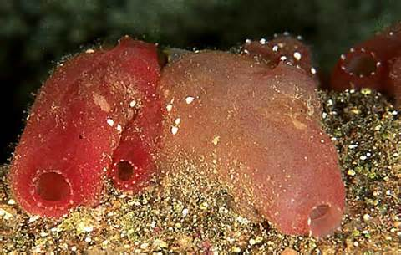
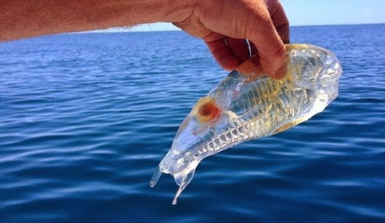
All chordates possess the following features:
have a notochord
have a dorsal nerve cord
are triploblastic
have paired gill pouches
are coelomate.

Slide 8
